Slide 1
Unconventional ferroelectricity and its polarization switching dynamics in moiré system
Physics Concerto, March 5th, 2025
Presenter: Kyoungpyo (KP) Lee

Slide 2
Outline
What is Ferroelectricity?
Ferroelectricity: introduction
Ferroelectric domains and domain wall
Polarization switching dynamics
Moiré ferroelectricity: a new type of ferroelectricity
Origin of Moiré ferroelectricity
Novel polarization switching: domain wall sliding
Moiré ferroelectrics as functional platform
Functional platform for physics
Engineering application

Slide 3
Outline
What is Ferroelectricity?
Moiré ferroelectricity: a new type of ferroelectricity
Moiré ferroelectrics as functional platform

Slide 4
Outline
What is Ferroelectricity?
Ferroelectricity: introduction
Ferroelectric domains and domain wall
Polarization switching dynamics
Moiré ferroelectricity: a new type of ferroelectricity
Moiré ferroelectrics as functional platform

Slide 5
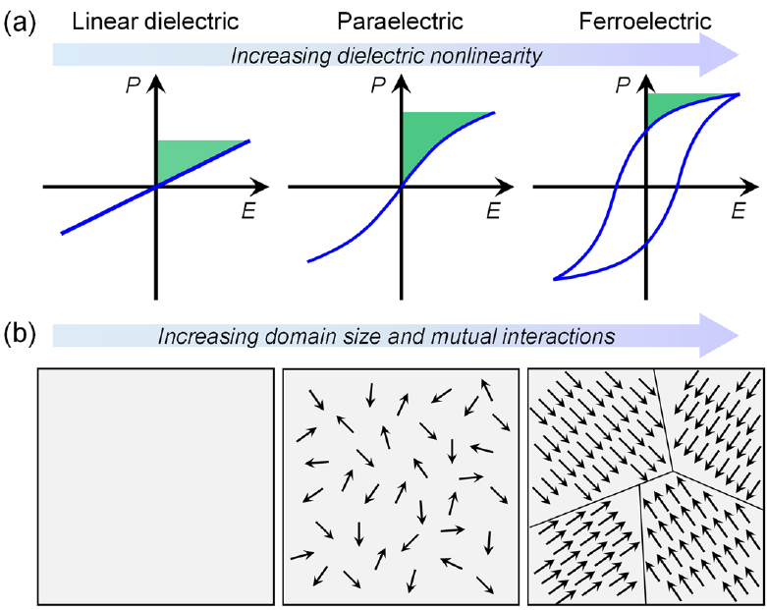
Ferroelectricity (FE): Introduction
Dielectric susceptibility of material
Highly nonlinear susceptibility leads to a remnant electrical polarization in the zero-field limit.
$$\vec{P}=χ_{E}\left(\vec{E}\right)\vec{E}$$
W. Lee et al. APL Materials 9.12 (2021).
Toprasertpong, Takenaka, & Shinichi Takagi. Applied Physics A 128.12 (2022): 1114.

Slide 6
Ferroelectricity (FE): Introduction
Energetic perspectives on FE: Polarization order driven by spontaneous inversion symmetry breaking
Linear
dielectric
$$E$$
LDE or PE
Paraelectric
$$P_{0}$$
Ferroelectric
$$P$$
FE
W. Lee et al. APL Materials 9.12 (2021)

Slide 7
Ferroelectric domains
Domain: A large cell in which every polarization aligns along a certain direction.
W. Lee et al. APL Materials 9.12 (2021).
Alikin et al. Materials 10.1 (2017): 47.

Slide 8
Ferroelectricity-driven fields
Depolarization field ($E_{dep}$): a built-in field generated by bound charge
Stray field ($E_{stray}$): a surrounding field generated by ferroelectric potential
$$E_{stray}$$
Two ways to minimize $E_{dep}$
D. M. Evans et al. Physical Sciences Reviews 5.9 (2020).

Slide 9
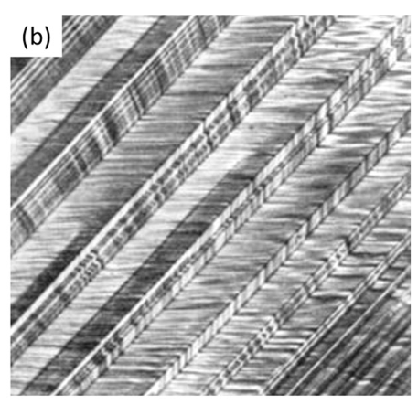
Ferroelectric domain wall
Domain wall: Line (1D) or surface (2D) boundary between one domain and the other.
W. Lee et al. APL Materials 9.12 (2021).
Scott et al. Applied Physics Reviews 4.4 (2017).

Slide 10
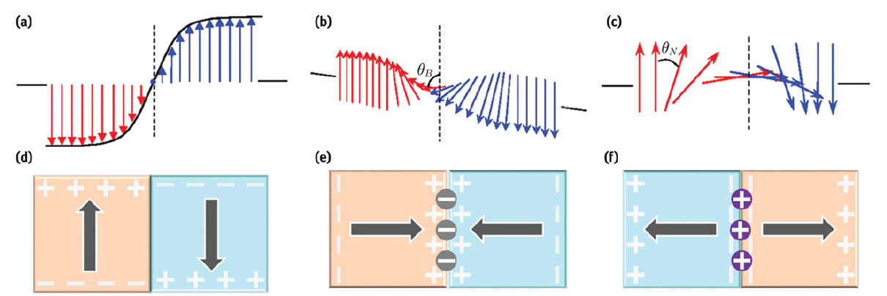
Domain wall characteristics
Types of domain wall: Ising, Bloch, Néel
Charge trap in the domain wall affects FE characteristics.
D. M. Evans et al. Physical Sciences Reviews 5.9 (2020).

Slide 11
Polarization switching
W. Lee et al. APL Materials 9.12 (2021).
Displacive Ferroelectrics
$BaTiO_{3}$, da Silva et.al, Tech. App. Nano. (2022)
S. Kunda et al. Scientific reports 5.1 (2015): 12415.

Slide 12
Outline
What is Ferroelectricity?
Moiré ferroelectricity and domain network
Towards a new type of ferroelectricity
Origin of Moiré ferroelectricity
Novel polarization switching dynamics
Moiré ferroelectrics as functional platform

Slide 13
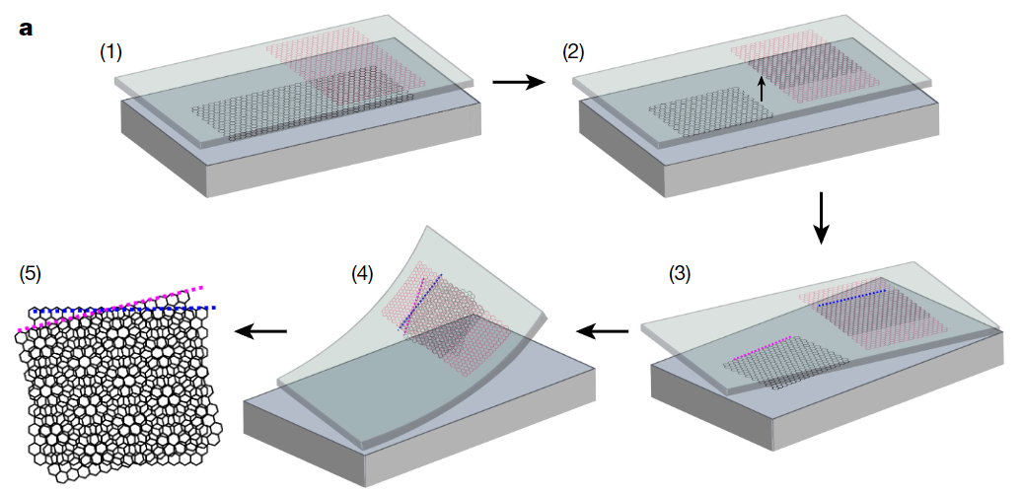
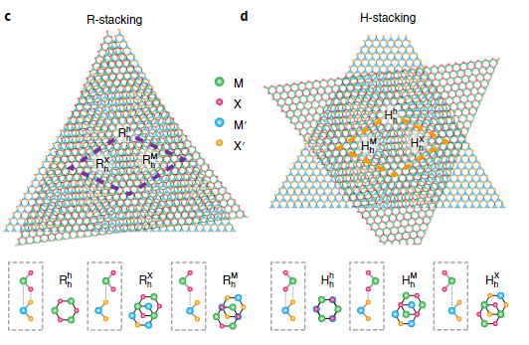
Towards a new type of ferroelectricity
Dry transfer / tear-and-stack method
Local inversion symmetry breaking
Moiré lattice
C. N. Lau, K. F. M. W. Bockrath, K. F. Mak*, F. Zhang*, Nature 602, 41–50 (2022)
D. Huang, J. Choi, C. K. Shih*, X. Li*, Nat. Nanotech. 17, 227–238 (2022).
Can we artificially generate ferroelectricity?

Slide 14
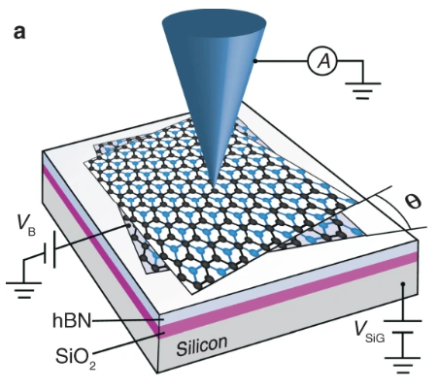
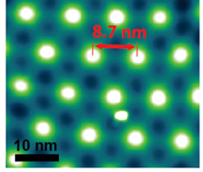
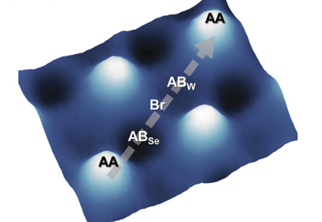
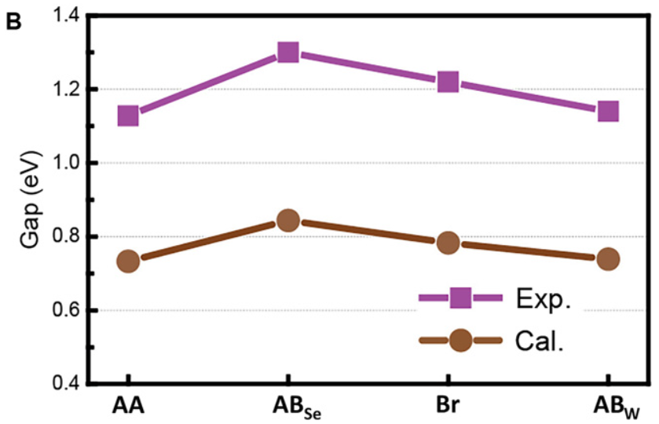
Towards a new type of ferroelectricity
Moiré potential as a hint
observed in MoS2/WSe2 heterobilayer
Scanning Tunneling Microscopy (STM)
X. Liu, A. Yazdani* et al. Nat Comm. 12, 2732 (2021)
C. Zhang, C.K. Shih* et al. Sci. Adv. 3, e1601459 (2017)

Slide 15
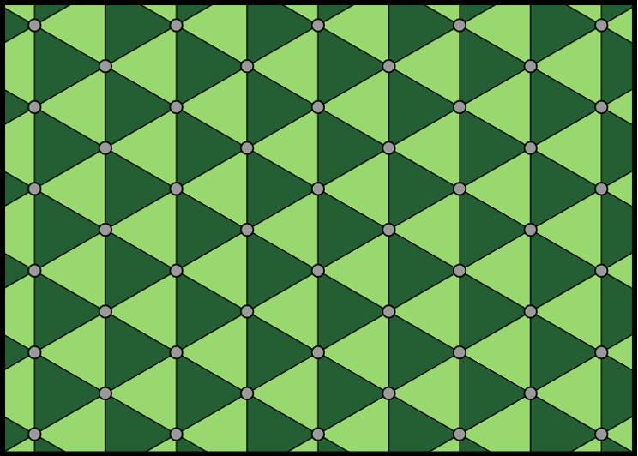
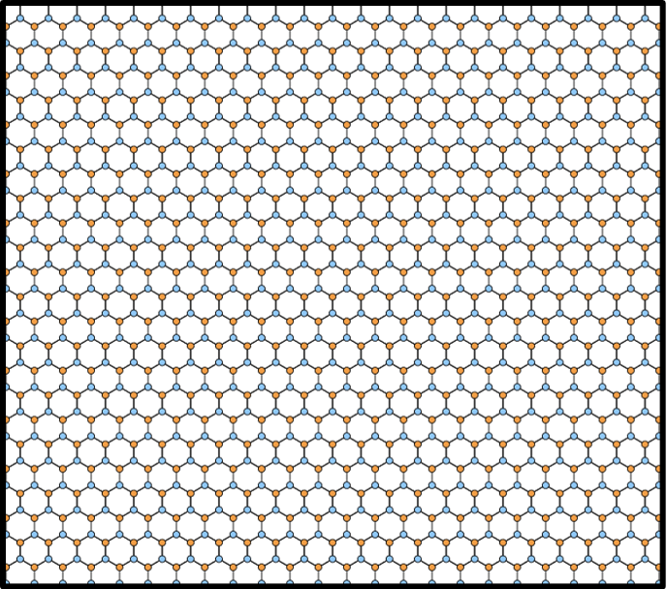
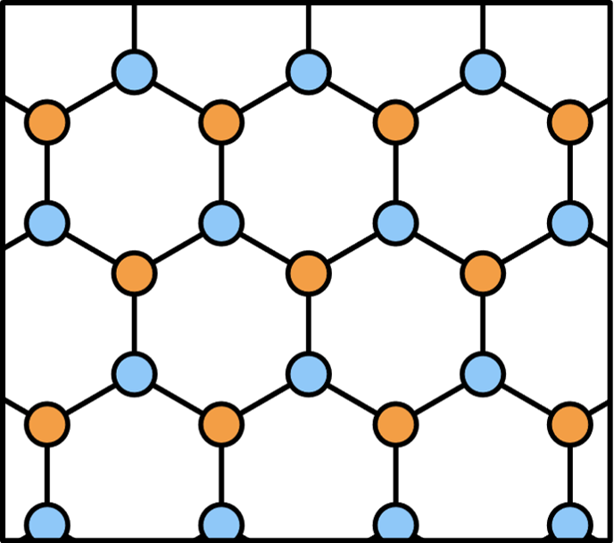
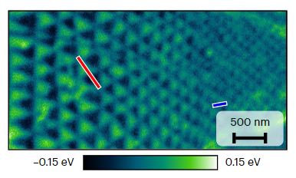
Origin of Moiré ferroelectricity
Boron
Nitrogen
D.S. Kim, X. Li* et al. Nat. Mater. 23, 65–70 (2024).

Slide 16
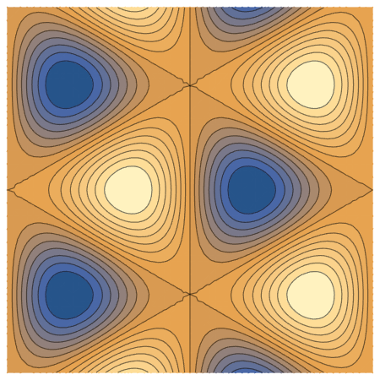
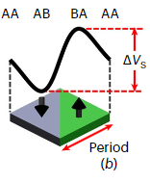
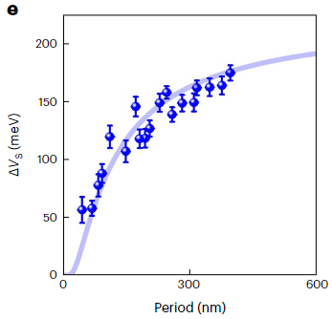
Origin of Moiré ferroelectricity
Predicted potential profile based on electronic charge redistribution.
$V\left(\vec{R},z\right)=\frac{1}{4πε_{0}}\int{\frac{Δρ\left({\vec{R}}^{′},z\right)}{\sqrt{{\left|\vec{R}−{\vec{R}}^{′}\right|}^{2}+{\left(z−z^{′}\right)}^{2}}}d{\vec{R}}^{′}dz′}≈\operatorname{sgn}\left(z\right)\frac{P\left(\vec{R}\right)}{2ε_{0}}\exp\left(−\frac{4π}{\sqrt{3}}\frac{\left|z\right|}{a_{M}}\right)$
$$P\left(\vec{R}\right)=P_{0}\left[\sin{{\vec{k}}_{M1}⋅\vec{R}}+\sin{{\vec{k}}_{M2}⋅\vec{R}}−\sin\left({\vec{k}}_{M1}+{\vec{k}}_{M2}\right)⋅\vec{R}\right]$$
D.S. Kim, X. Li* et al. Nat. Mater. 23, 65–70 (2024).

Slide 17
Polarization switching in moiré system
How to switch moiré FE domains using electrical field?
Possible mechanism of polarization switching
Charge “re-redistribution” under the applied field
Domain wall sliding due to the mechanical shift in stacking geometry
Well…?
Still ongoing investigation!

Slide 18
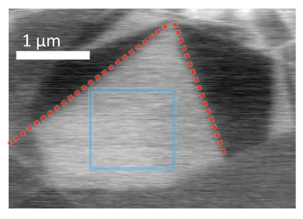
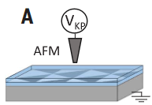
Polarization switching in moiré system
Domain wall sliding in an isolated (or wall-pinned) domain
V. Stern, M. Ben Shalom* et al. Science 372, 1462–1466 (2021)

Slide 19
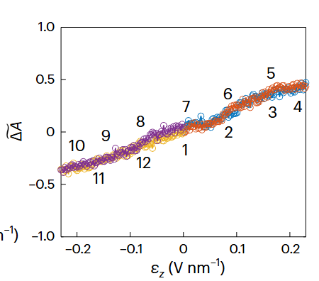
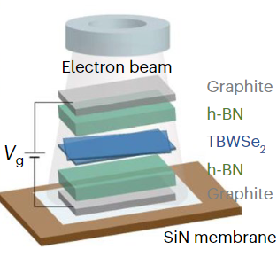
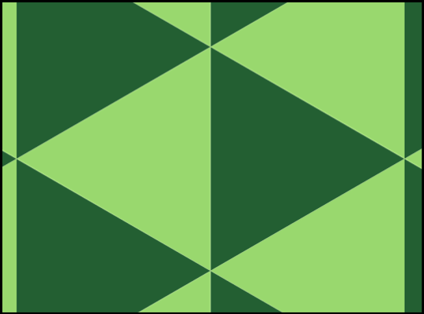
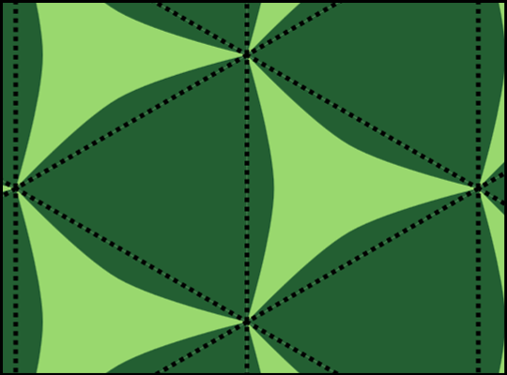
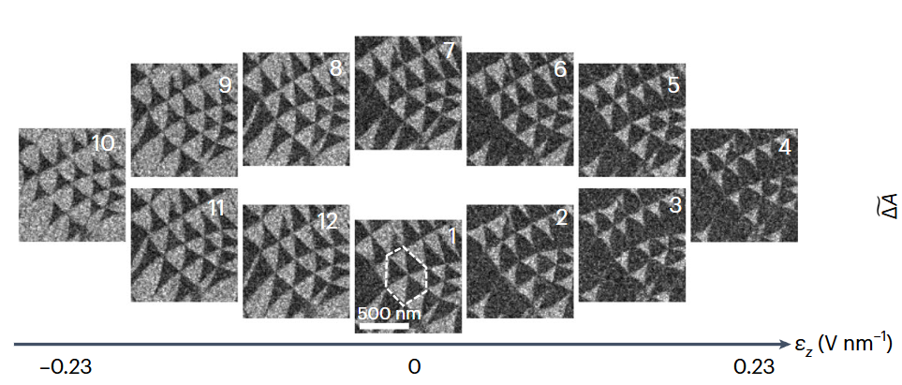
Polarization switching in moiré system
Domain expansion/shrinkage in the domain network
Almost no hysteresis observed in a pure moiré domain network.
Operando Trasmission Electron Microscopy (TEM)
K. Ko, P. Kim*, H. Yoo* et al. Nat. Mater. 22, 992–998 (2023).

Slide 20
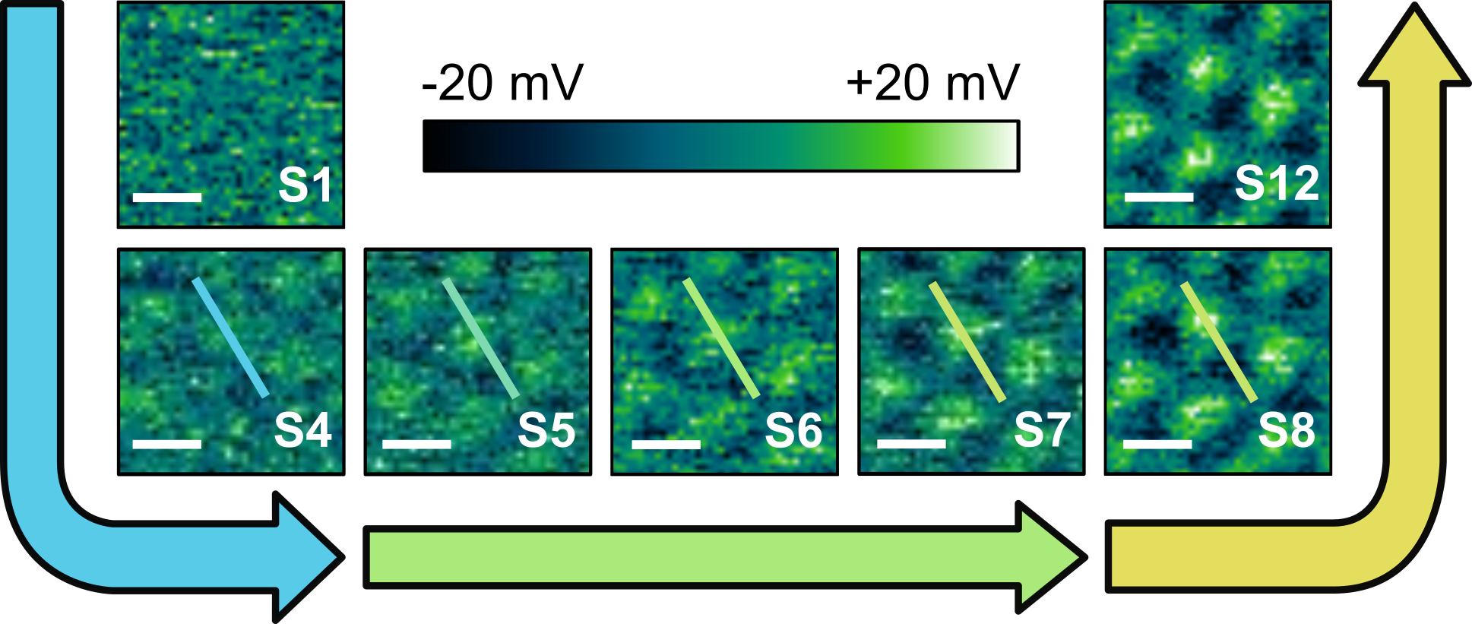
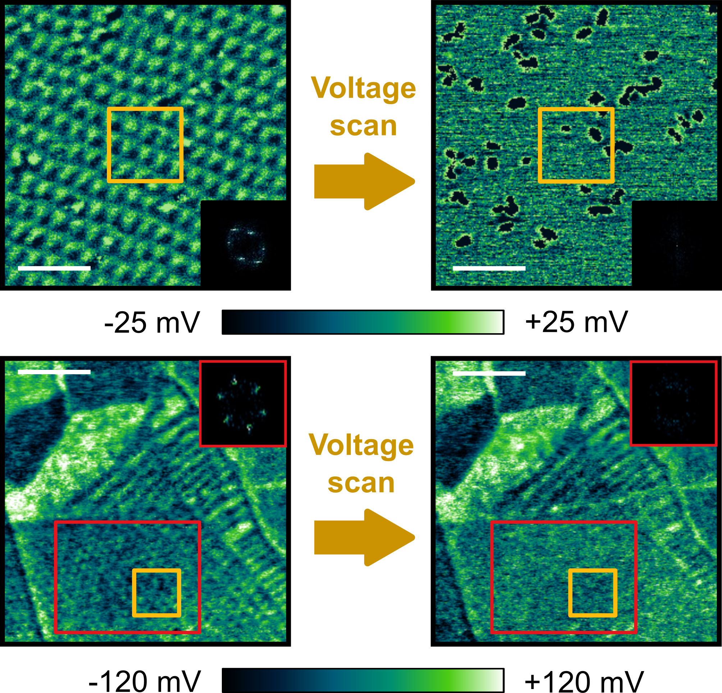
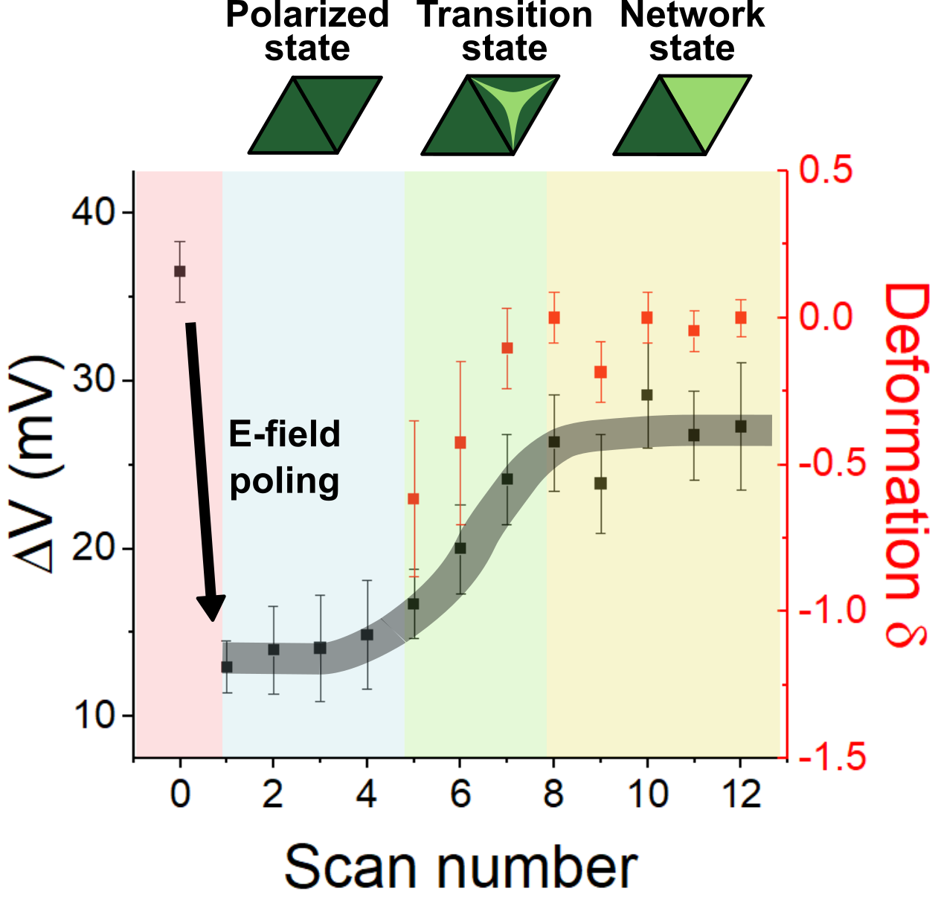
Polarization switching in moiré system
Network-based global switching
KP Lee, X. Li*, in progress

Slide 21
Outline
What is Ferroelectricity?
Moiré ferroelectricity: a new type of ferroelectricity
Moiré ferroelectrics for applications
Functional platform for physics
Engineering application

Slide 22
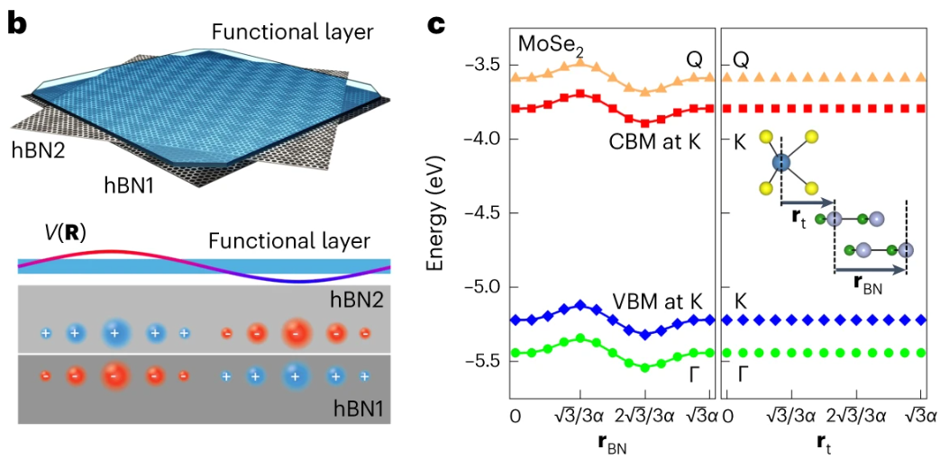
Moiré ferroelectrics as functional platform
D.S. Kim, X. Li* et al. Nat. Mater. 23, 65–70 (2024).

Slide 23
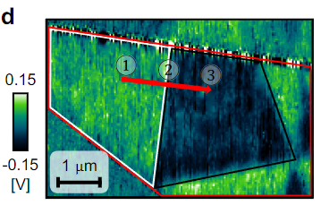
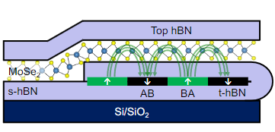
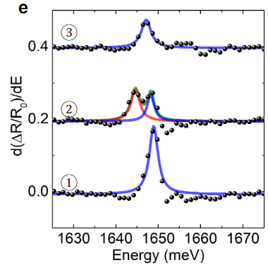
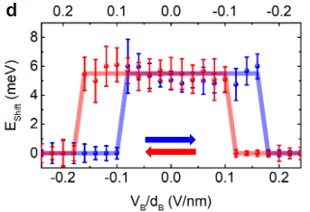
Remote engineering of electronic states
Optical sensing of new stark-shifted exciton in Moiré FE domain wall.
Device structure
D.S. Kim, X. Li* et al. Nat. Mater. 23, 65–70 (2024).

Slide 24
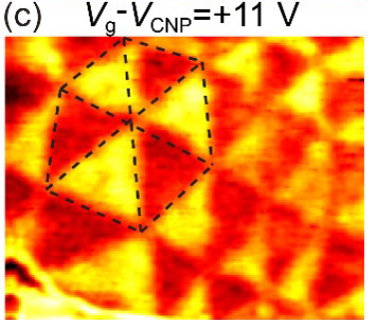
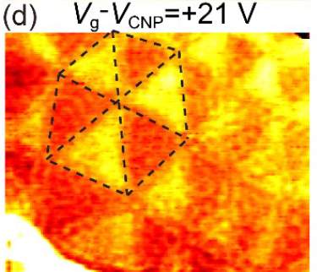
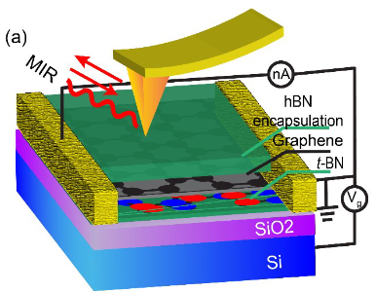
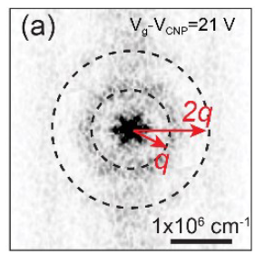
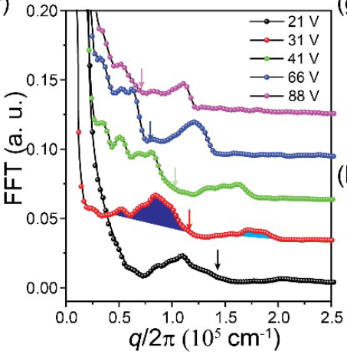
Remote engineering of electronic states
Moiré FE domain-assisted plasmonic excitation in graphene/t-hBN
Scanning near-field
Optical microscopy
Zhang et al. arXiv preprint arXiv:2406.18028 (2024).

Slide 25
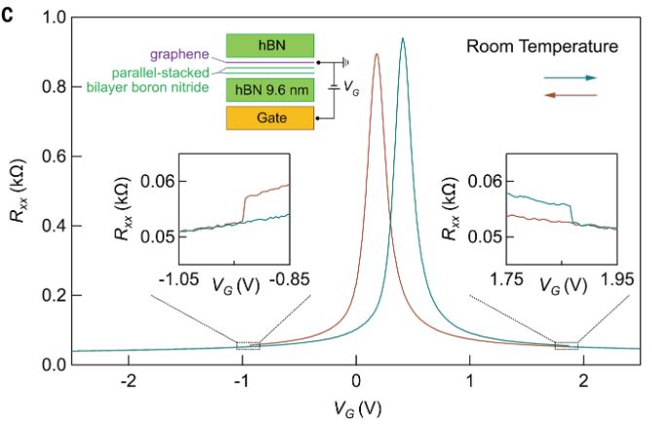
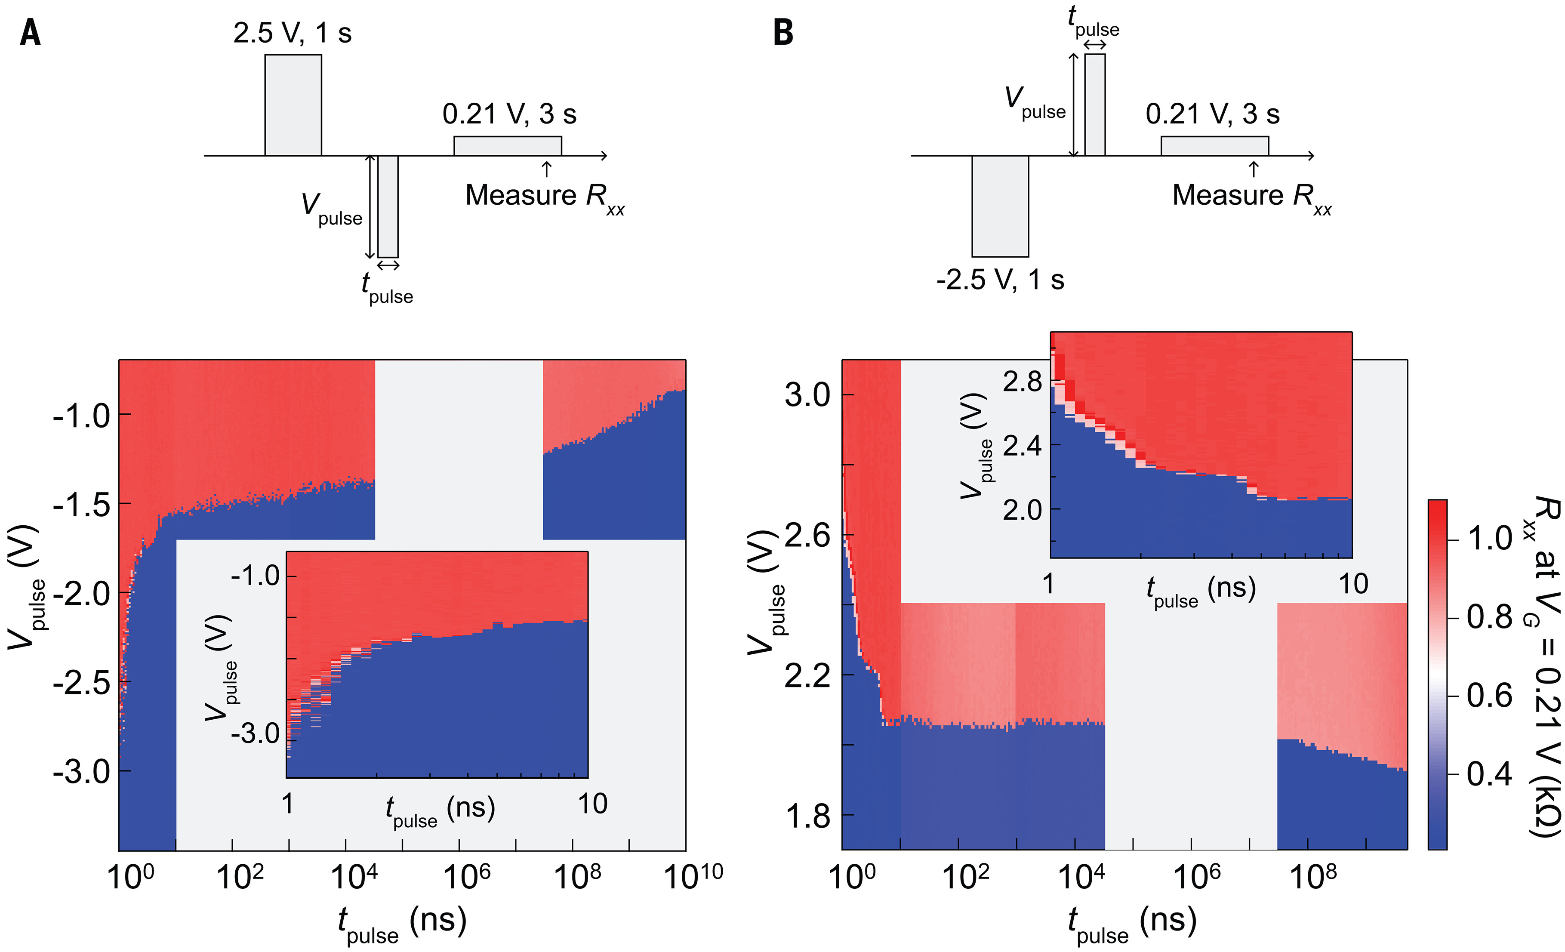
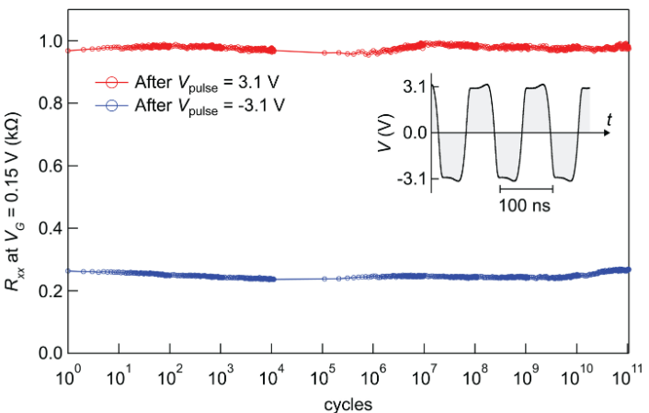
Devices for engineering application
A new stark-shifted exciton in Moiré FE domain wall.
K. Yasuda, P. Kim*, R. Ashoori* et al. Science (2024): eadp3575.

Slide 26
Thank you!

